Slide 1
Suricata安裝
智慧資安三 410580028 林韋杉

Slide 2
01
Guest Additions 安裝
02
Suricata 安裝
contents
03
json 解析工具安裝
04
Suricata 規則

Slide 3
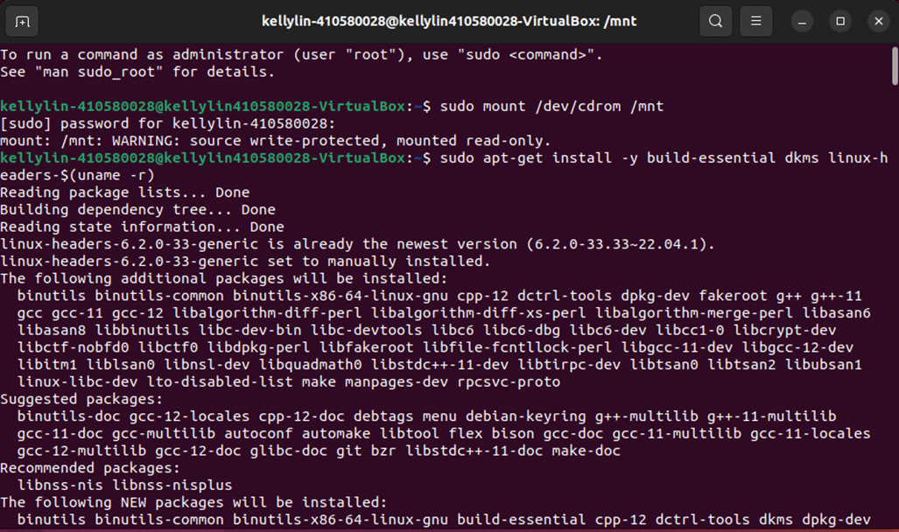
Guest Additions 安裝
sudo apt-get install -y build-essential dkms linux-headers-$(uname -r)

Slide 4
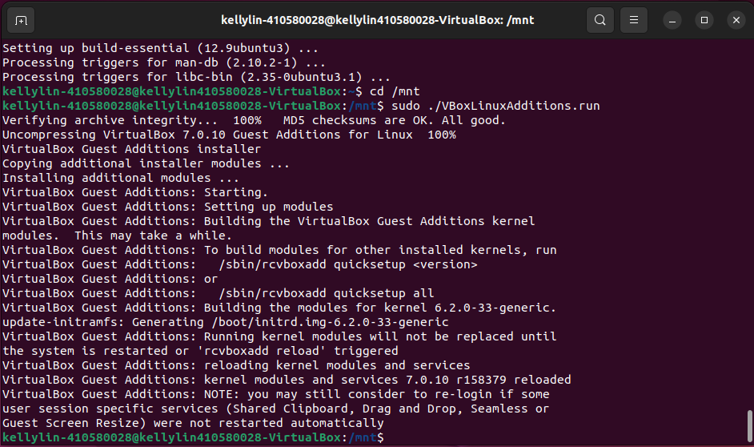
Guest Additions 安裝
cd /mnt
sudo ./VBoxLinuxAdditions.run
重新啟動

Slide 5
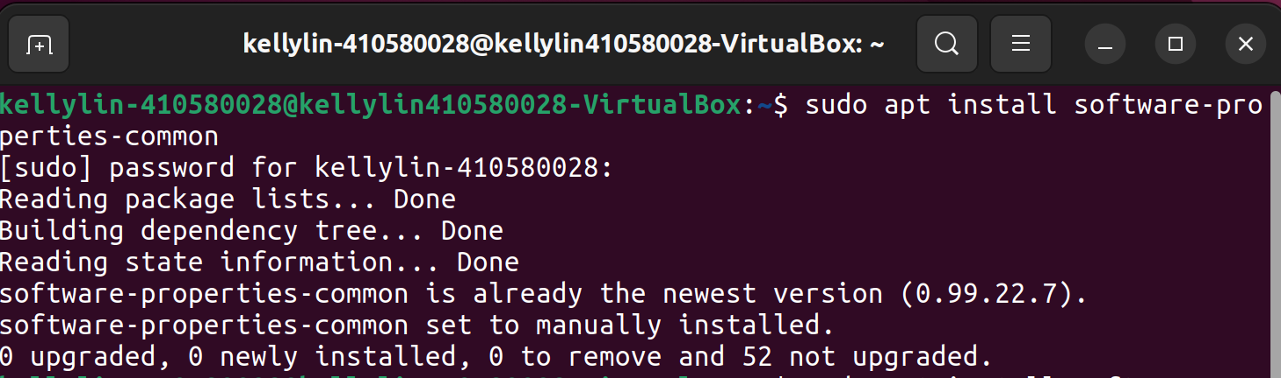
Suricata 安裝
sudo apt install software-properties-common

Slide 6
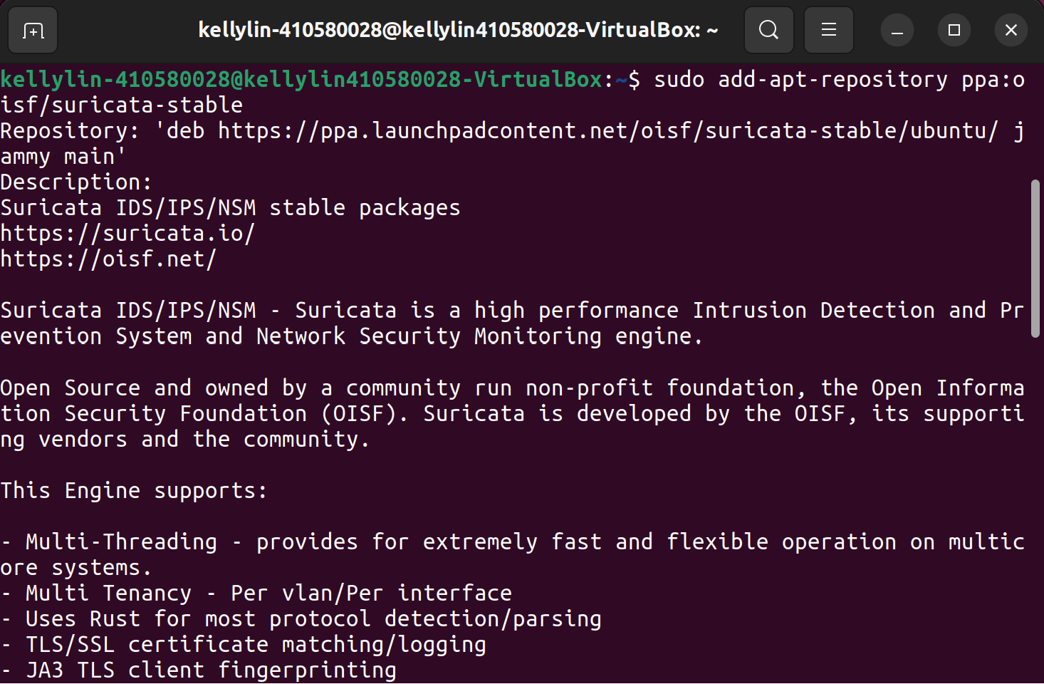
Suricata 安裝
sudo add-apt-repository ppa:oisf/suricata-stable

Slide 7
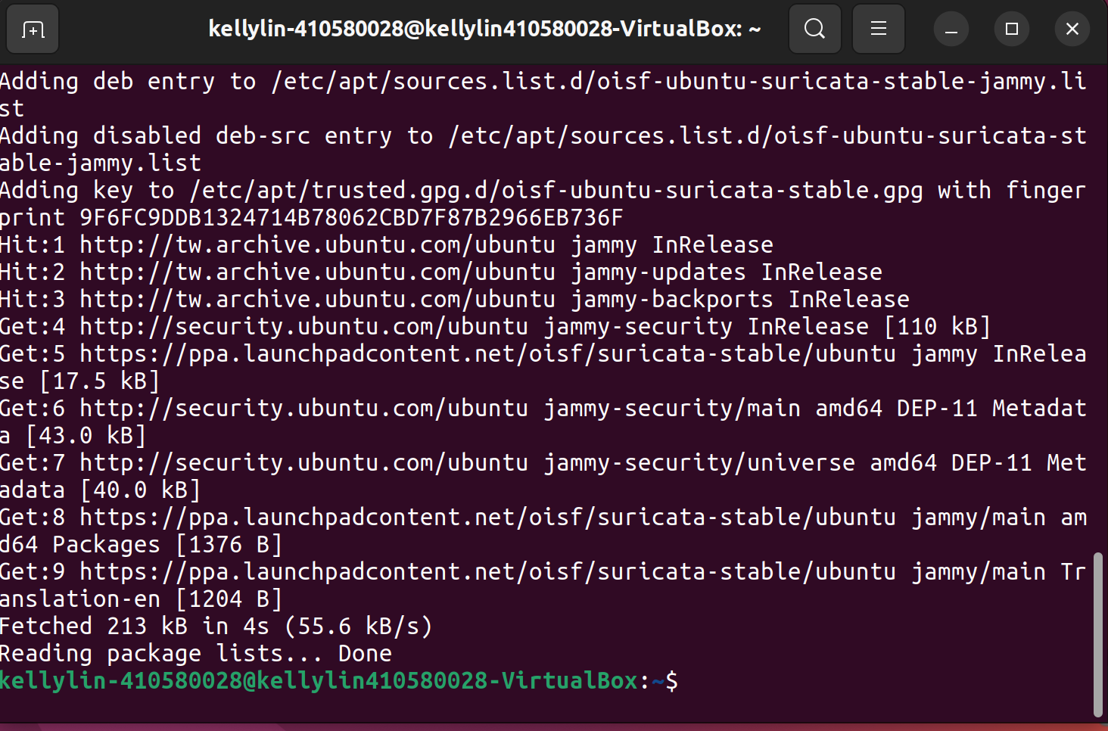
Suricata 安裝
sudo add-apt-repository ppa:oisf/suricata-stable

Slide 8
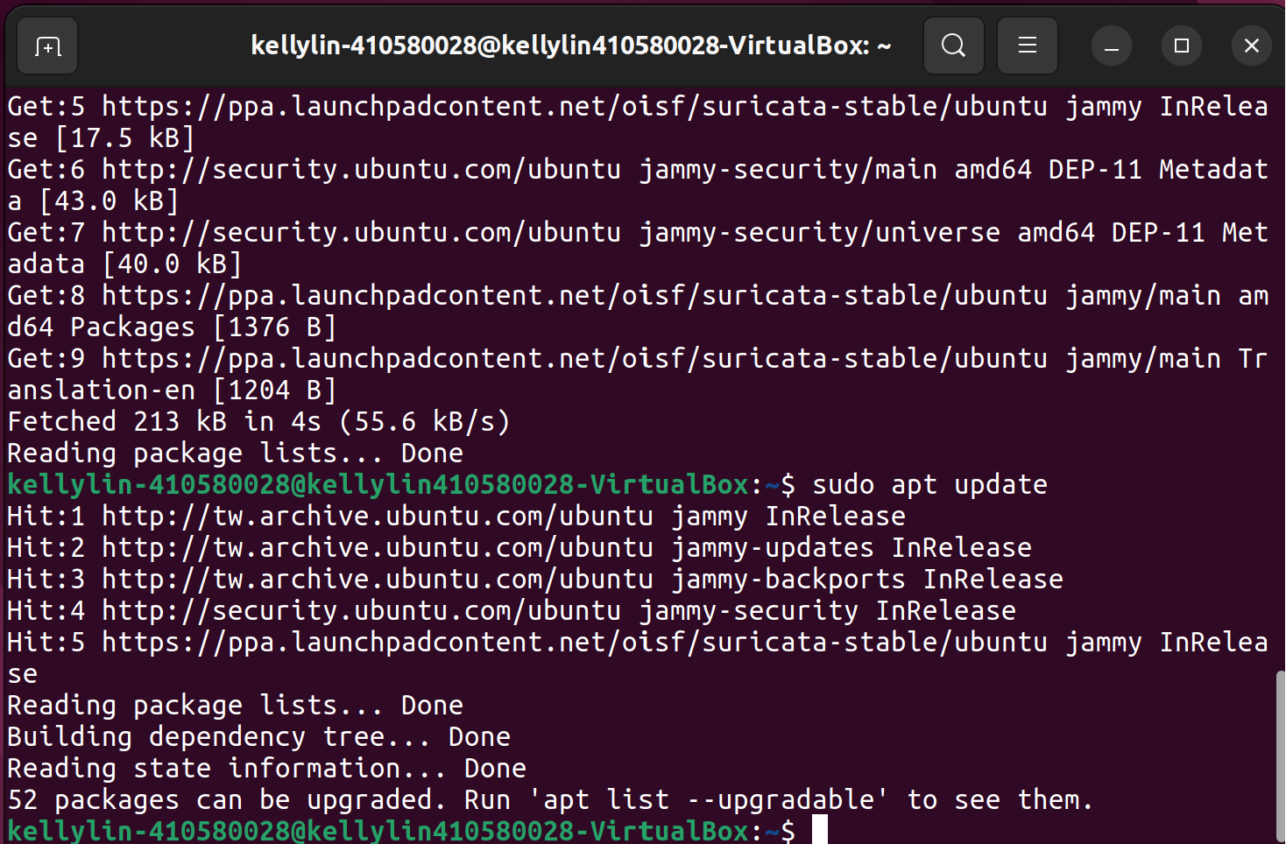
Suricata 安裝
sudo apt update

Slide 9
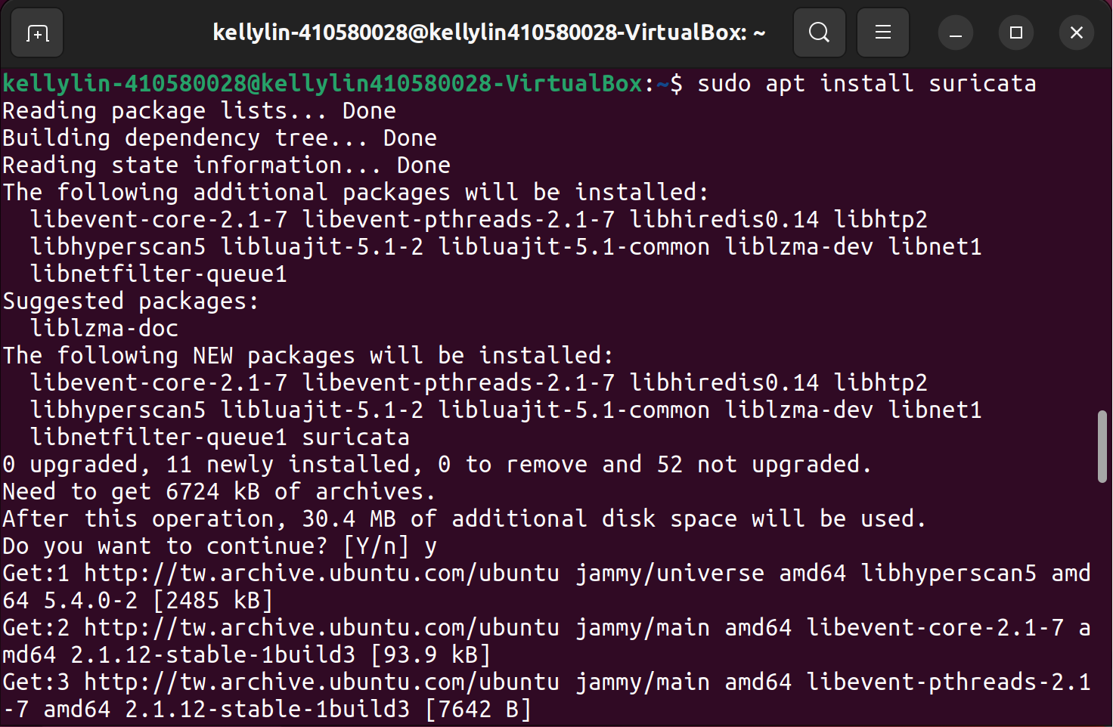
Suricata 安裝
sudo apt install suricata

Slide 10
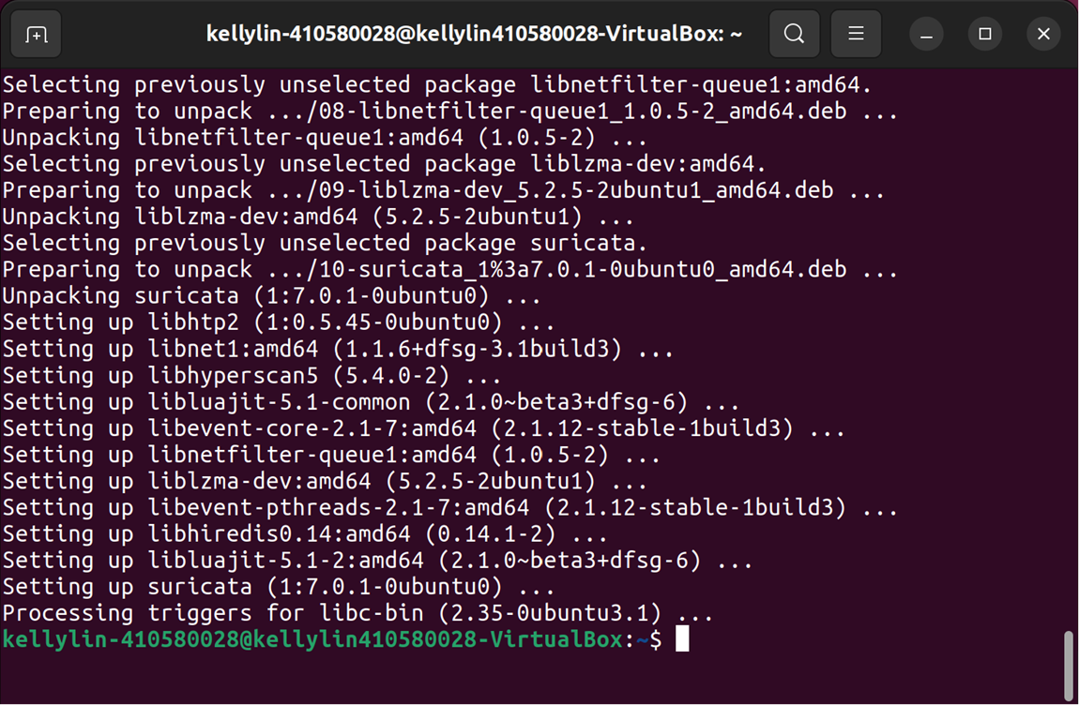
Suricata 安裝
sudo apt install suricata

Slide 11
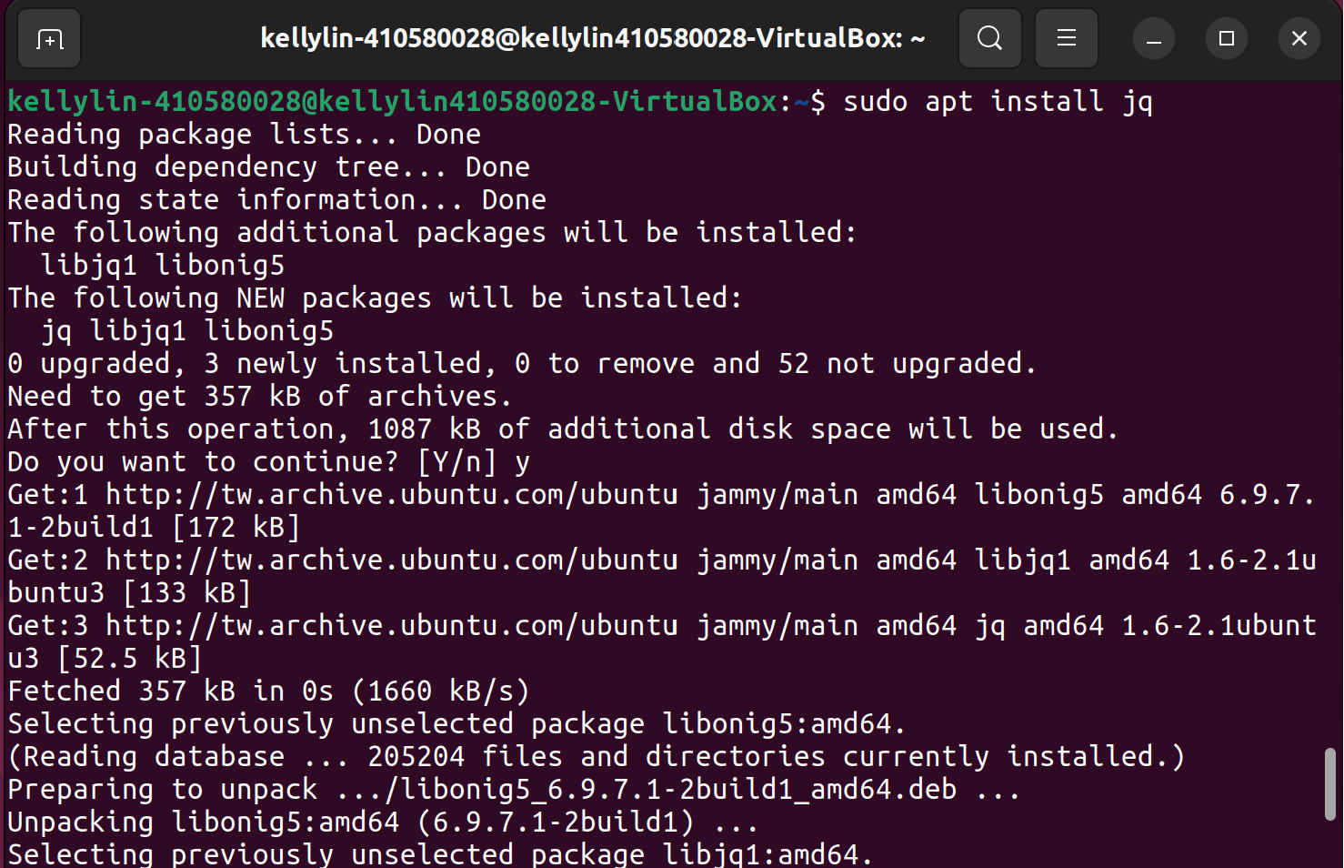
json 解析工具安裝
sudo apt install jq

Slide 12
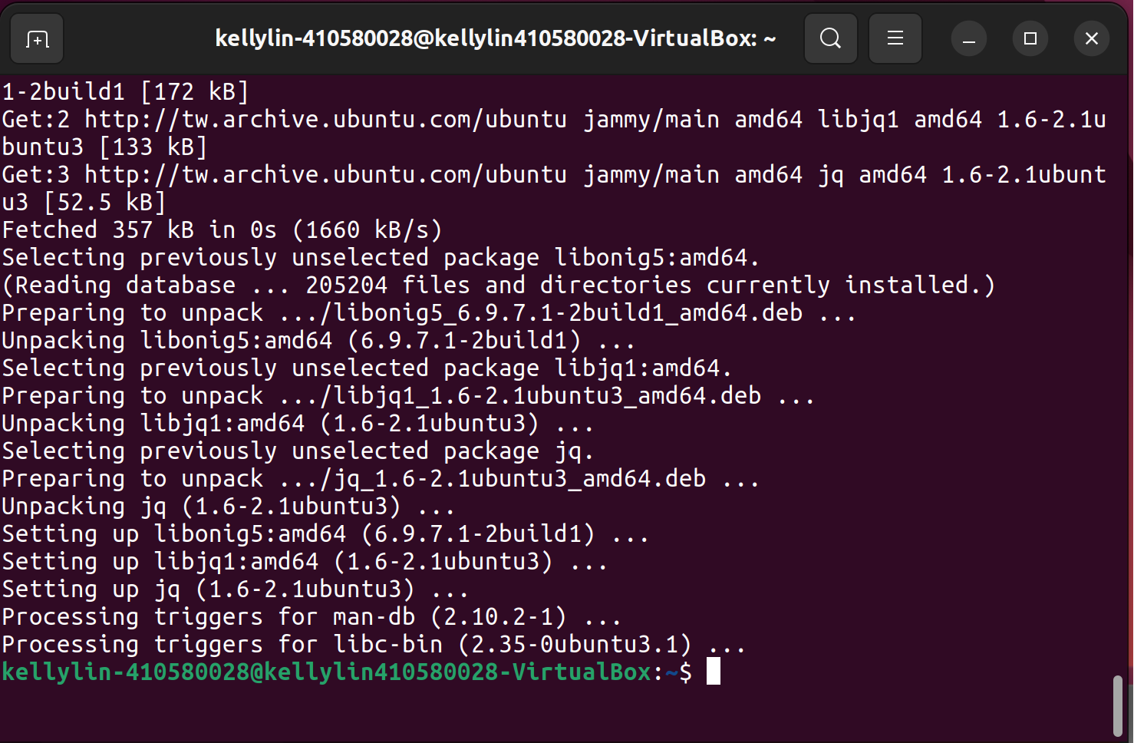
json 解析工具安裝
sudo apt install jq

Slide 13
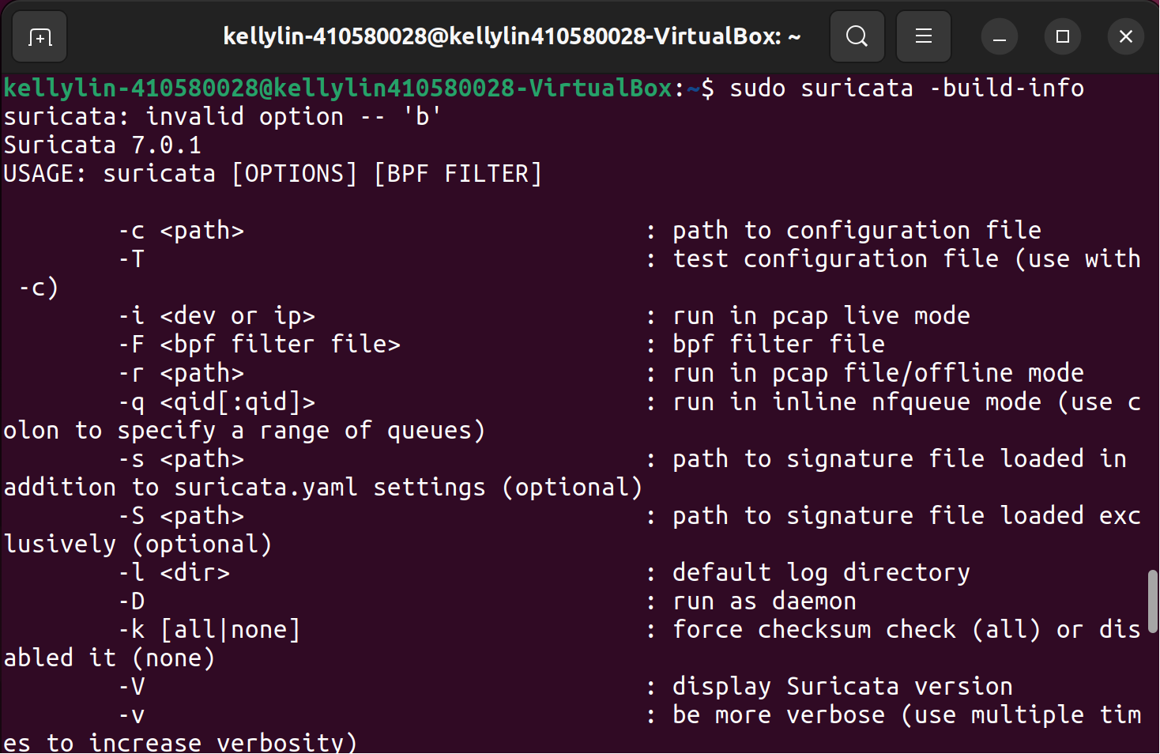
Suricata 安裝結果
sudo suricata –build-info

Slide 14
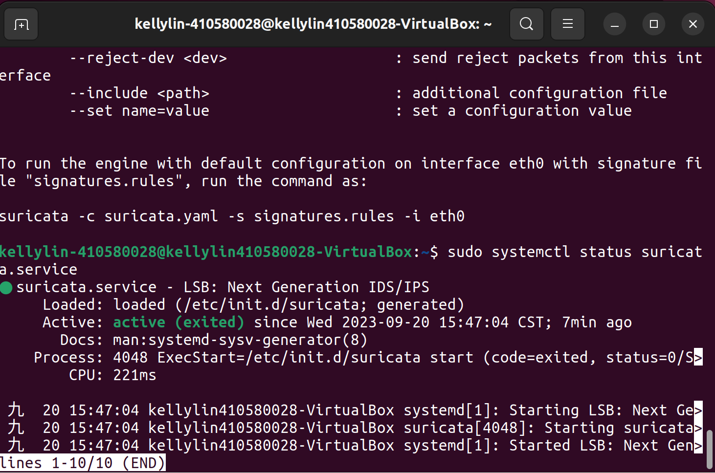
Suricata服務狀態
sudo systemctl status suricata.service

Slide 15
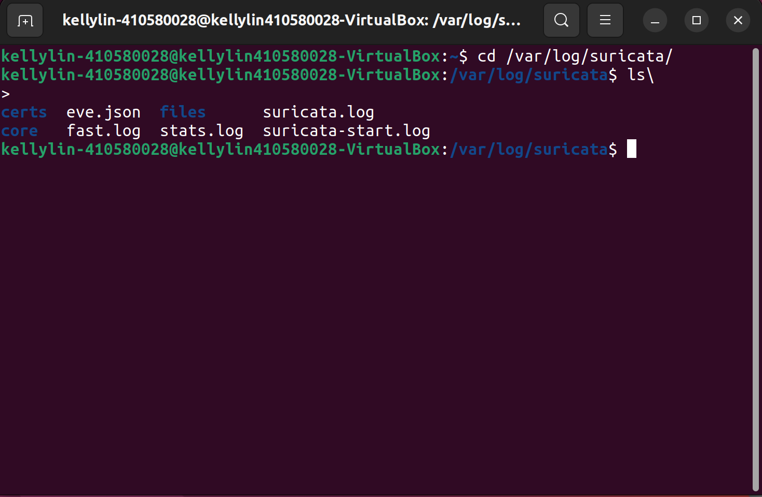
Suricata log
cd /var/log/suricata/

Slide 16
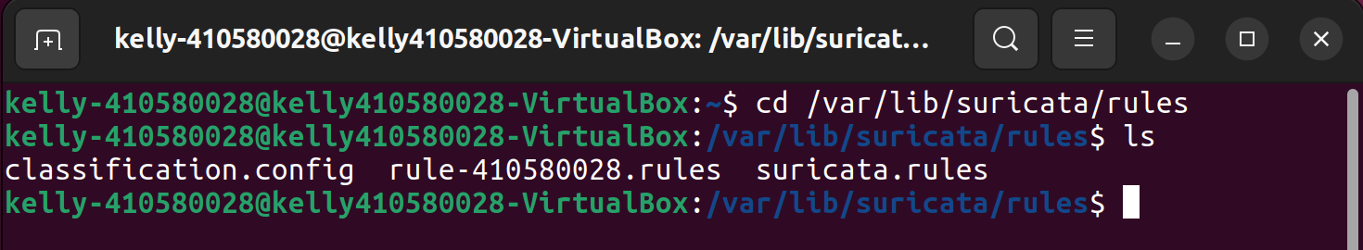
Suricata rules
cd /var/lib/suricata/rules

Slide 17
Suricata config
cd /etc/suricata

Slide 18
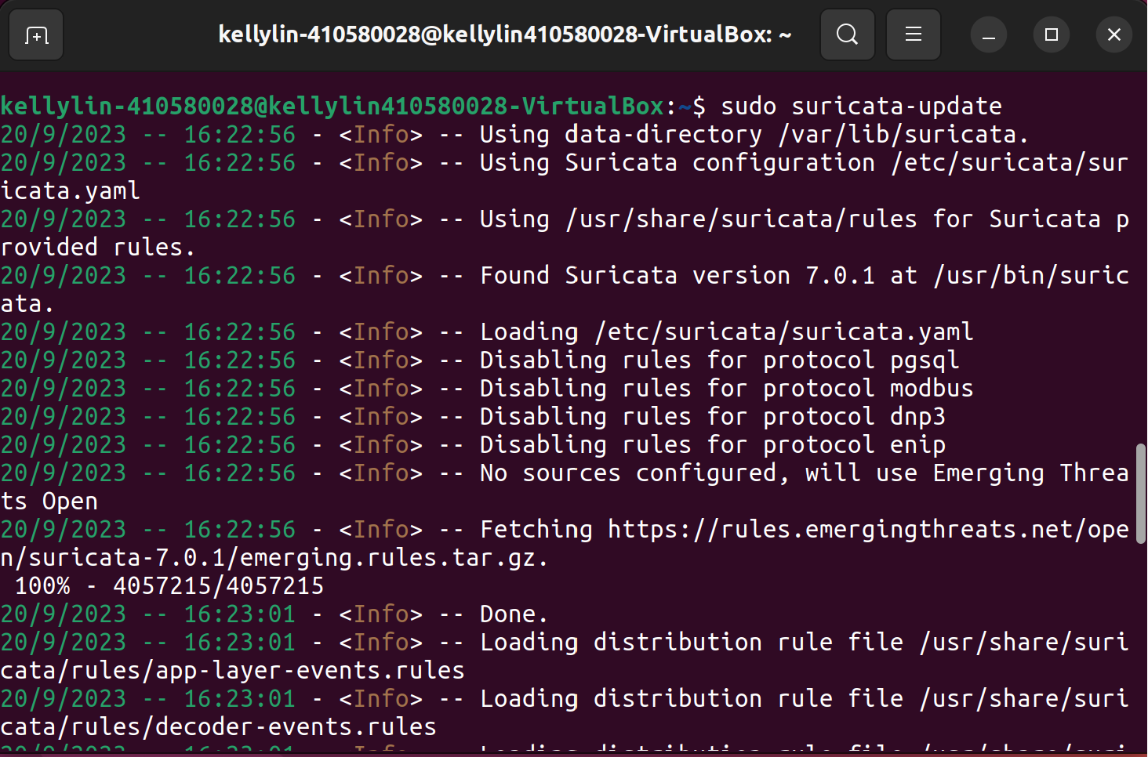
Suricata 規則更新
cd /etc/Suricata
sudo suricata-update

Slide 19
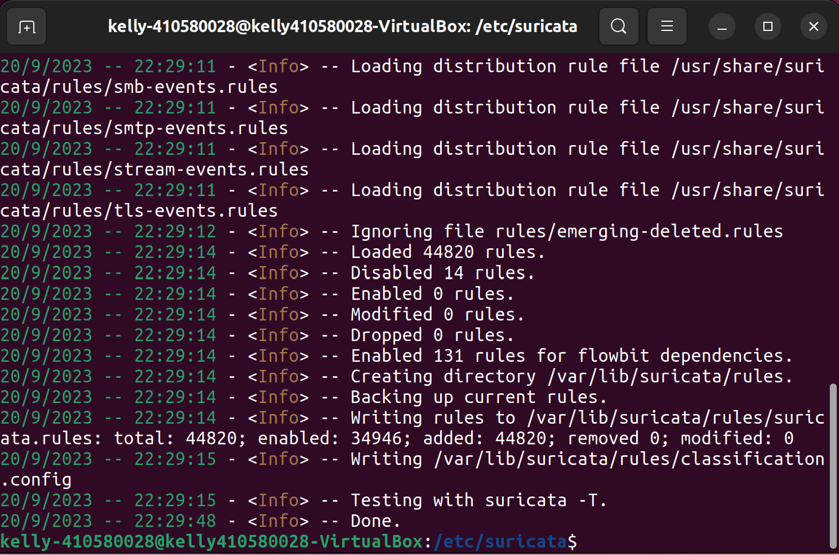
Suricata 規則更新
cd /etc/Suricata
sudo suricata-update

Slide 20
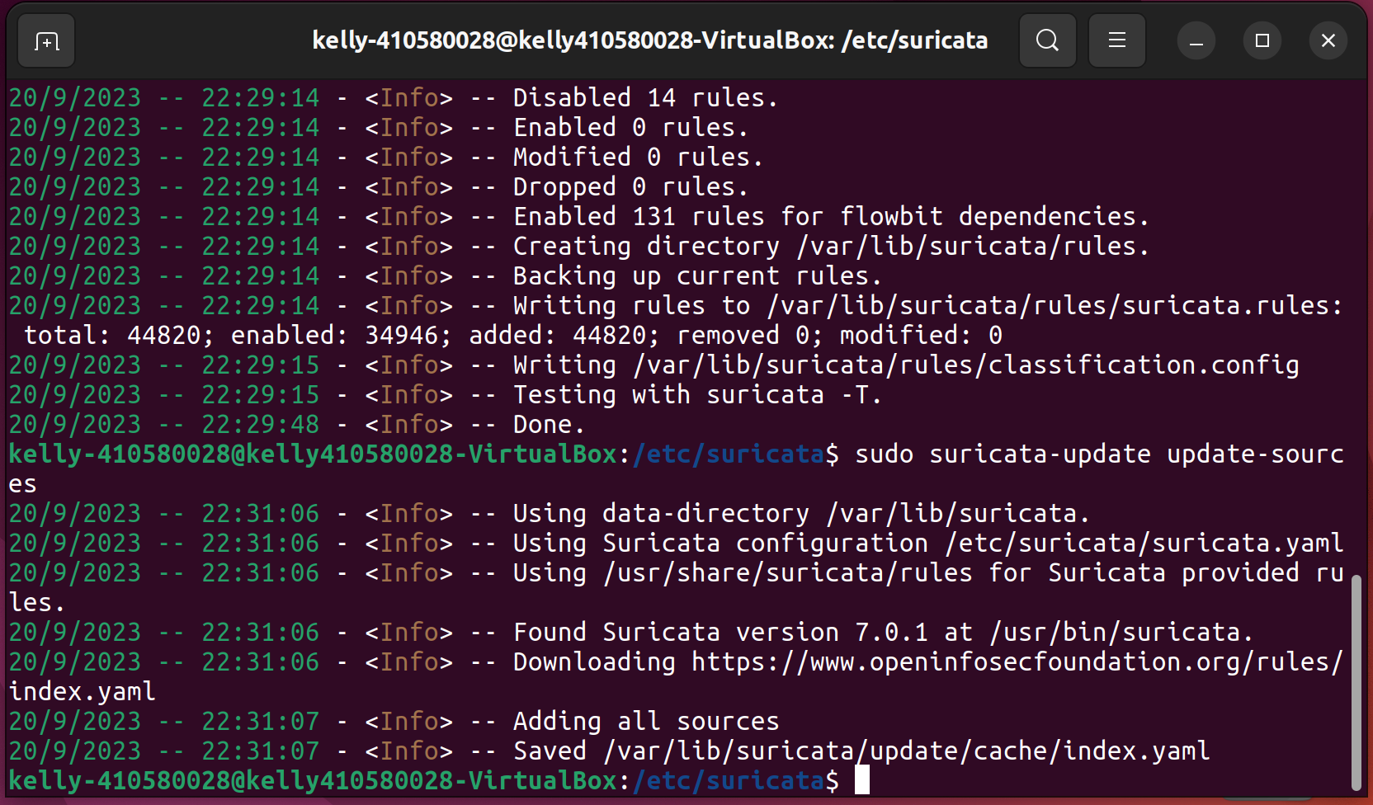
Suricata 最新規則
sudo suricata-update update-sources

Slide 21
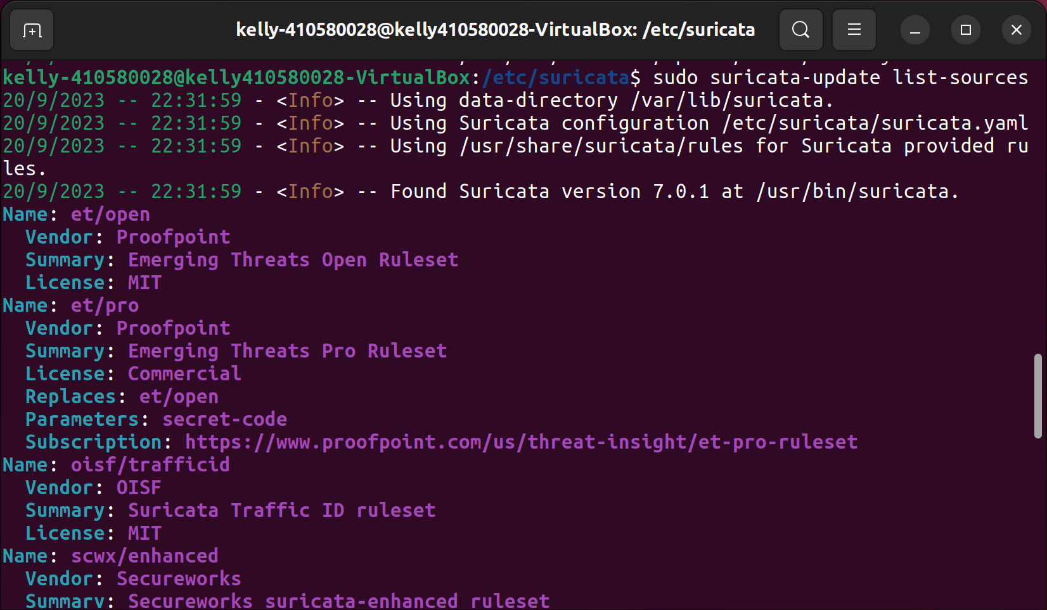
Suricata 查看規則
sudo suricata-update list-sources

Slide 22
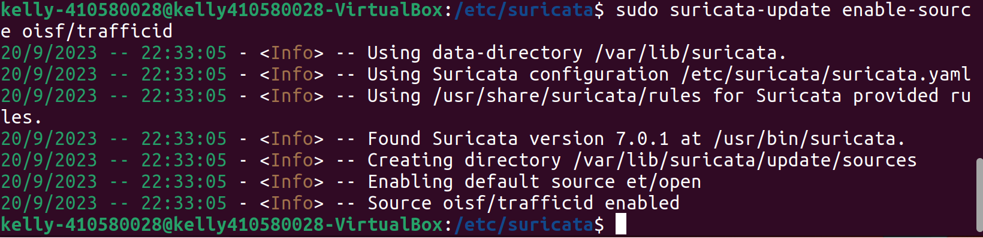
Suricata 新增規則
sudo suricata-update list-sources

Slide 23
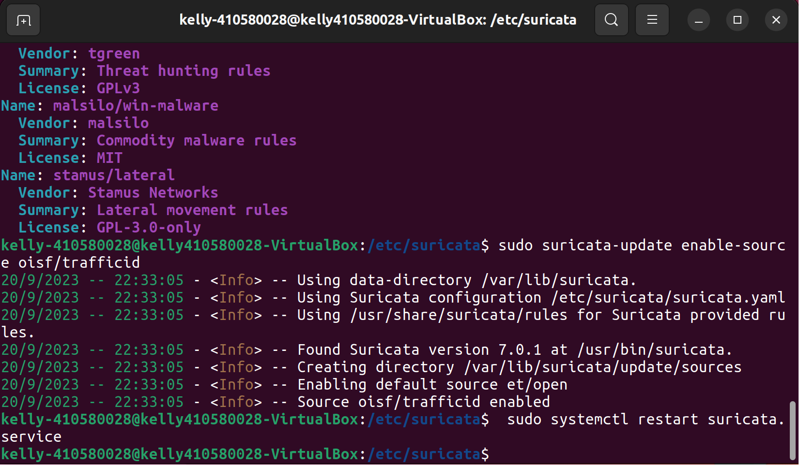
Suricata 重新加載規則
sudo systemctl restart suricata.service

Slide 24
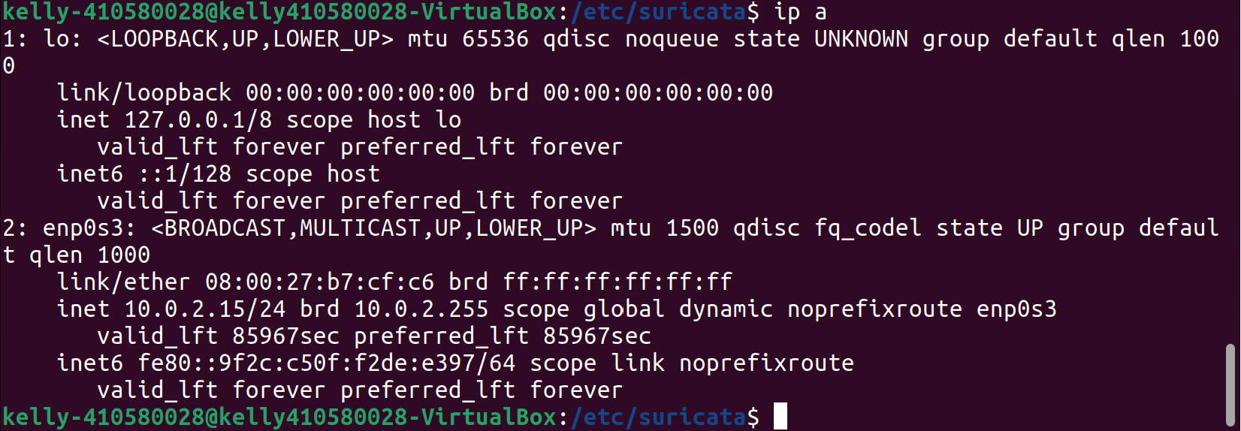
Suricata 找網路卡&ip
Ip a

Slide 25
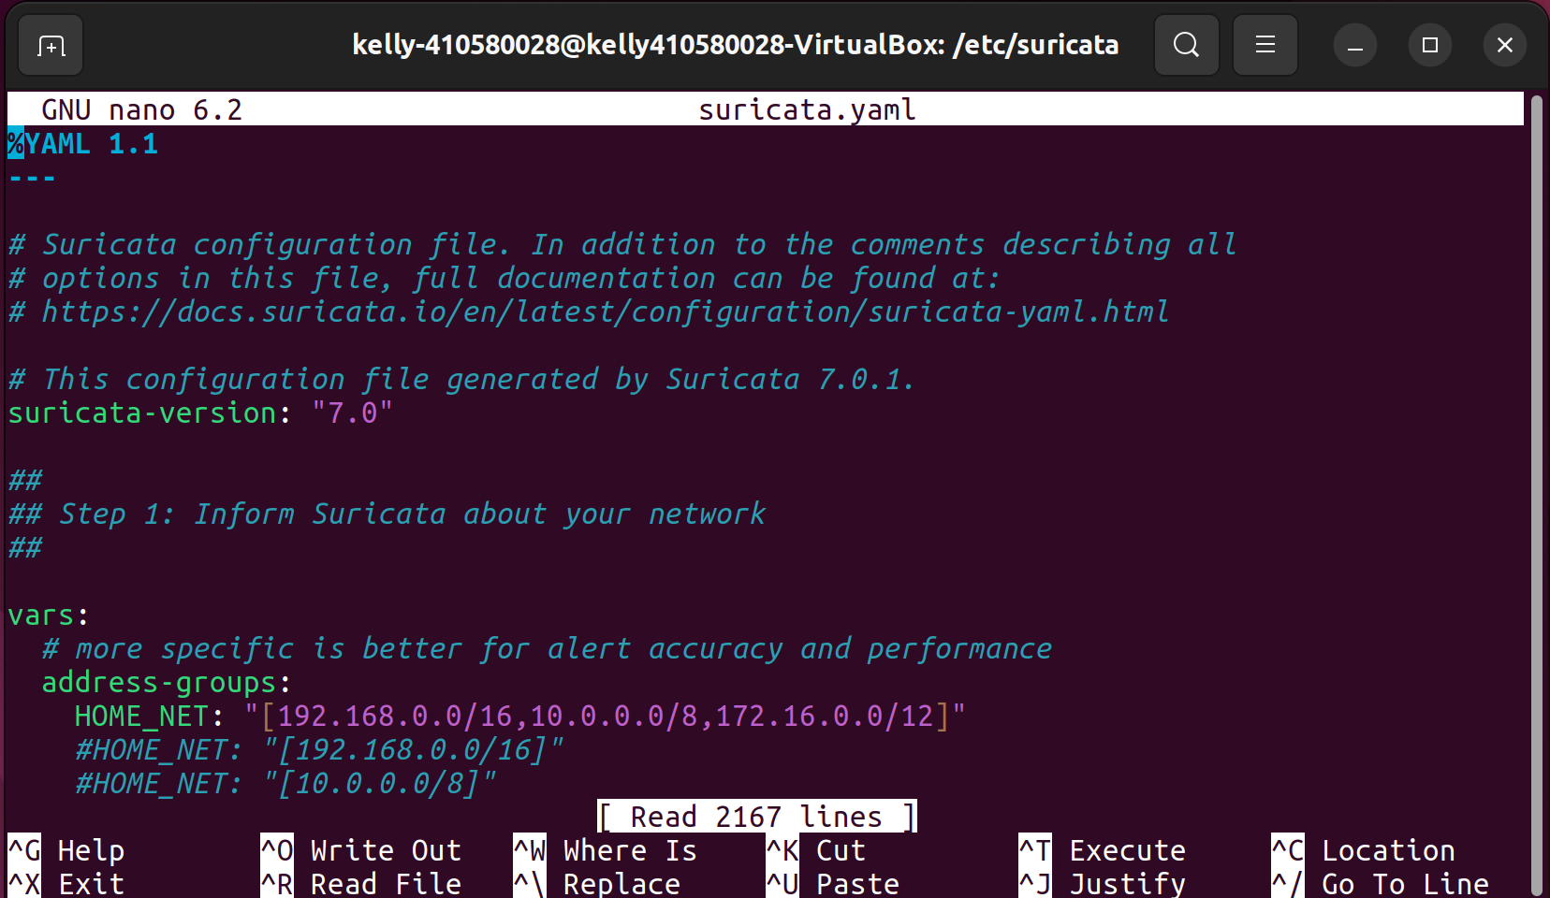
Suricata 改interface&ip

Slide 26
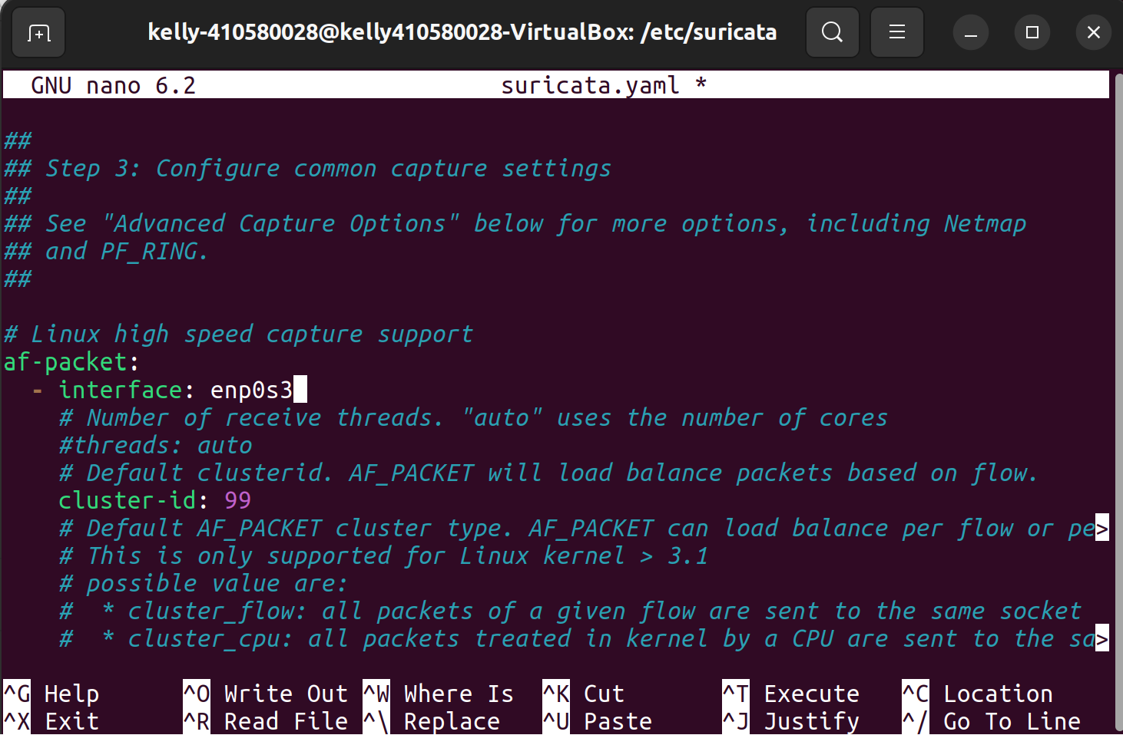
Suricata 改interface&ip

Slide 27
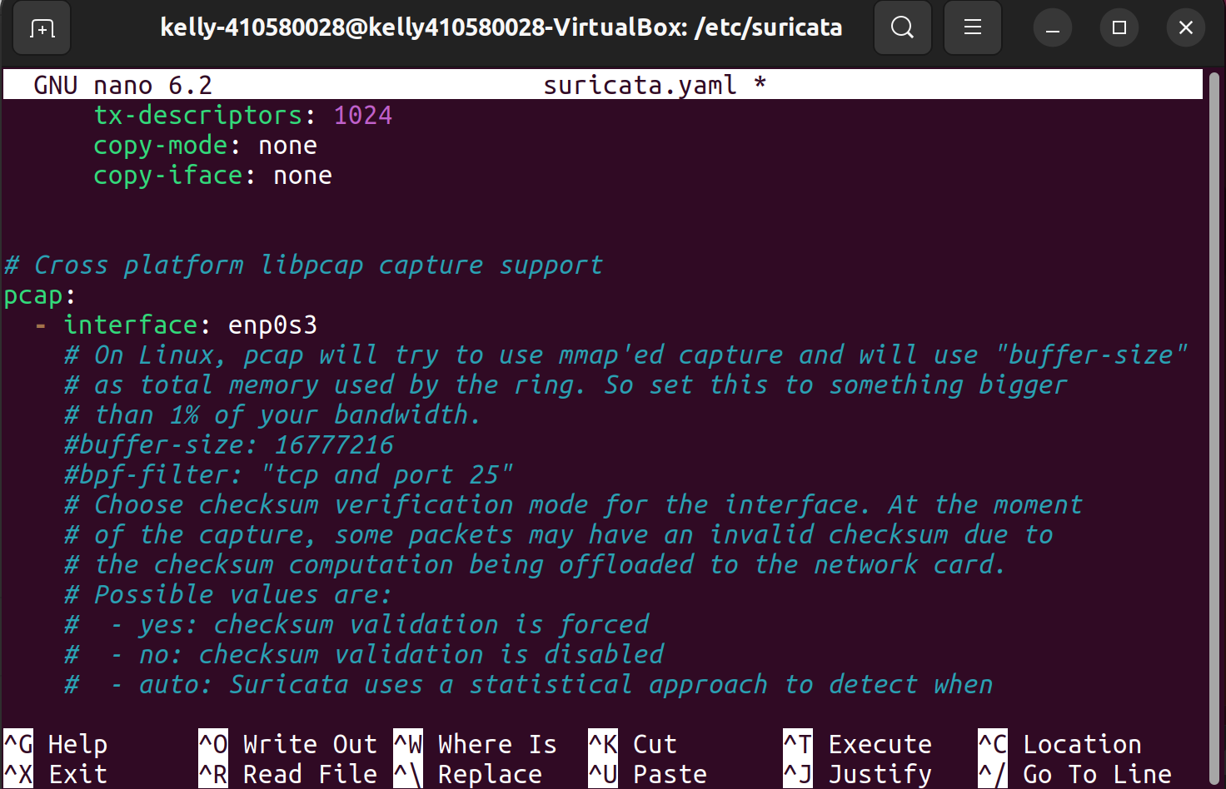
Suricata 改interface&ip

Slide 28
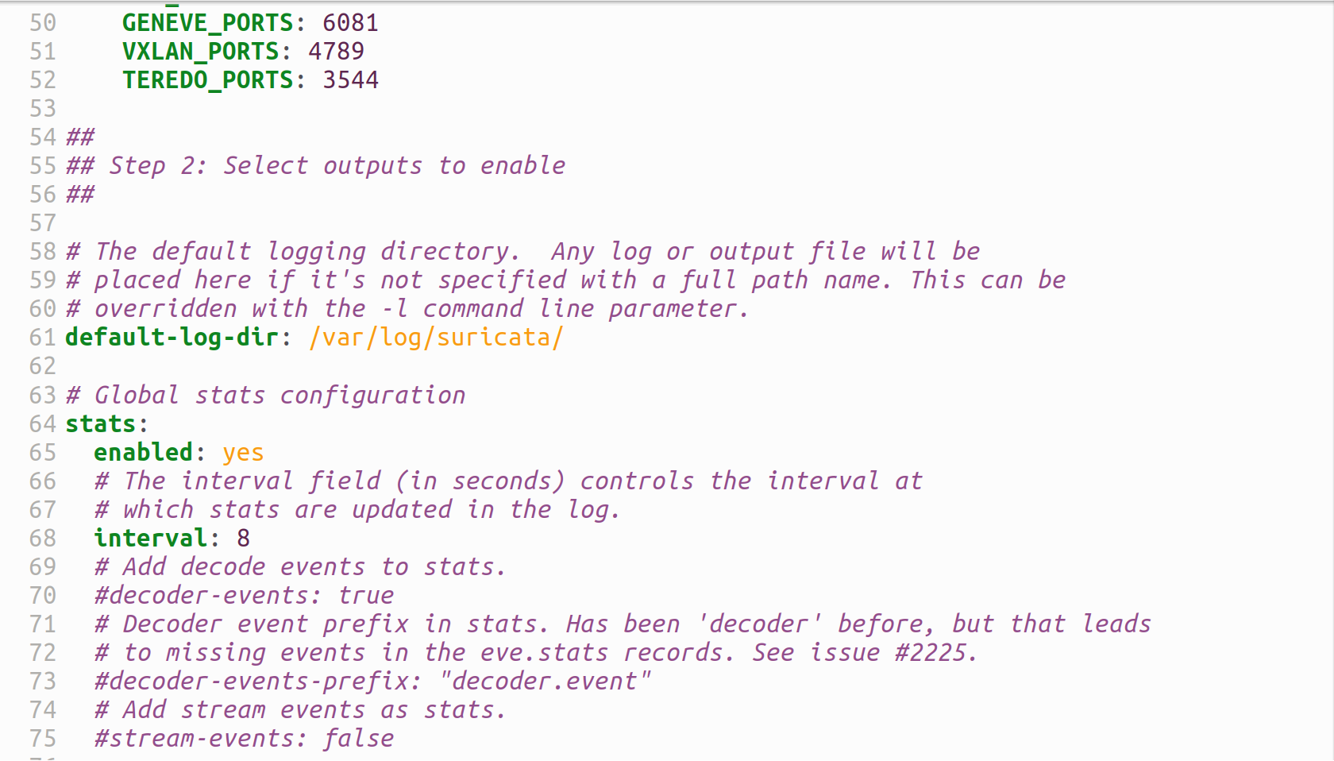
Suricata 記錄檔位置

Slide 29
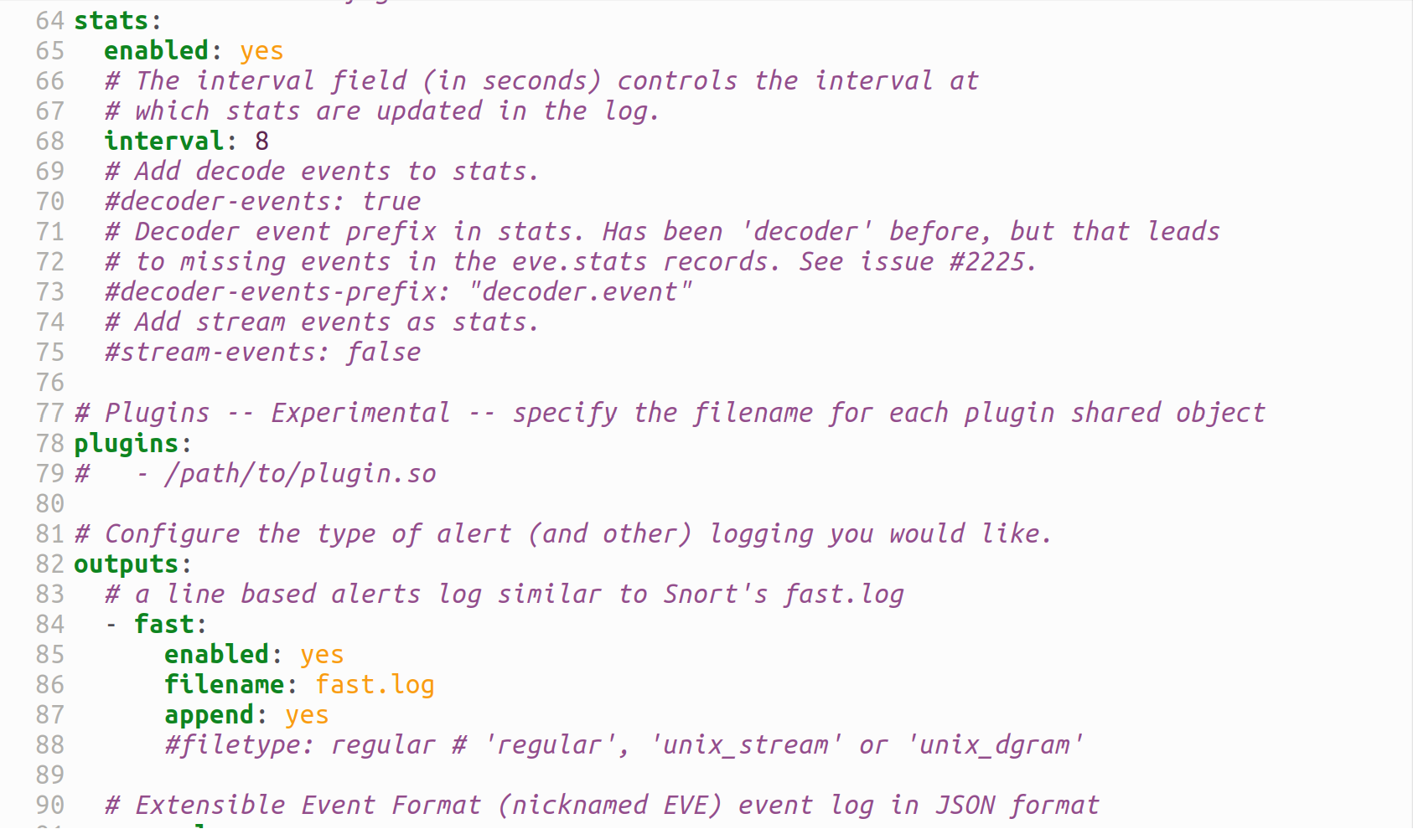
Suricata 紀錄檔案頻率

Slide 30
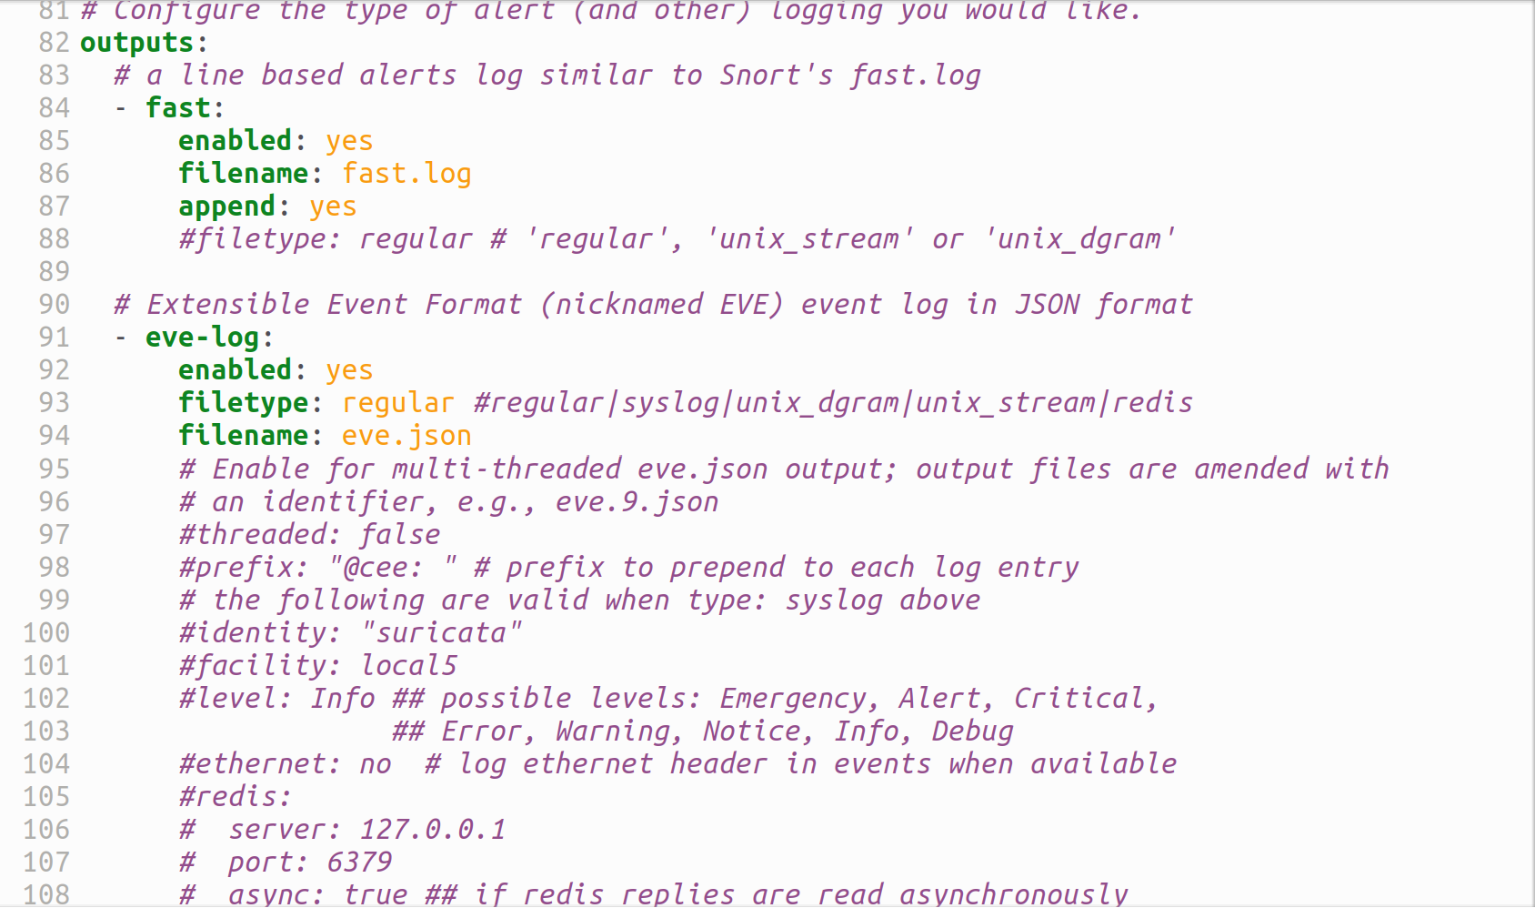
Suricata 紀錄檔案名稱

Slide 31
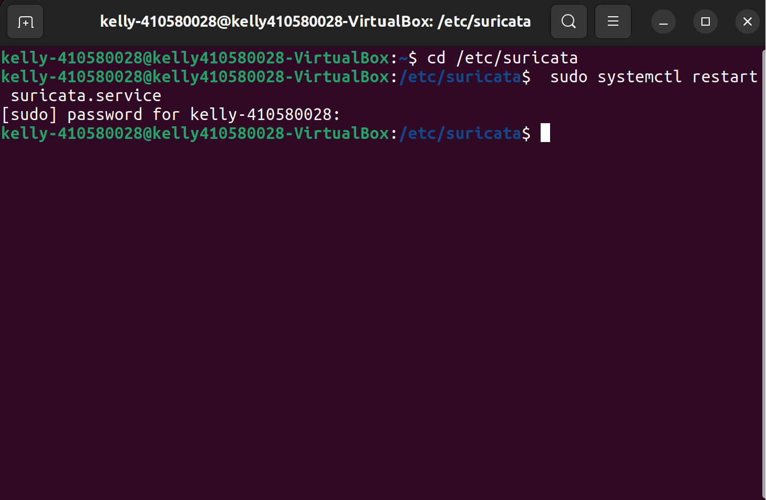
Suricata 重新啟用
sudo systemctl restart suricata.service

Slide 32
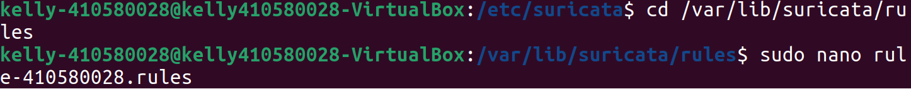
Suricata 新增規則
Cd /var/lib/Suricata/rules
sudo nano rule-410580028.rules

Slide 33
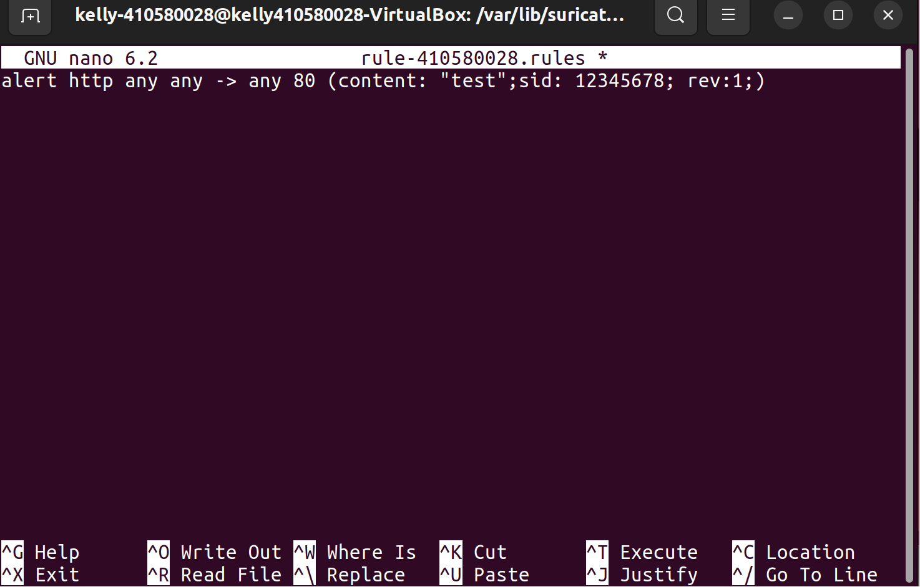
Suricata 新增規則
alert http any any -> any 80 (content: “test”;sid: 12345678; rev:1;)

Slide 34
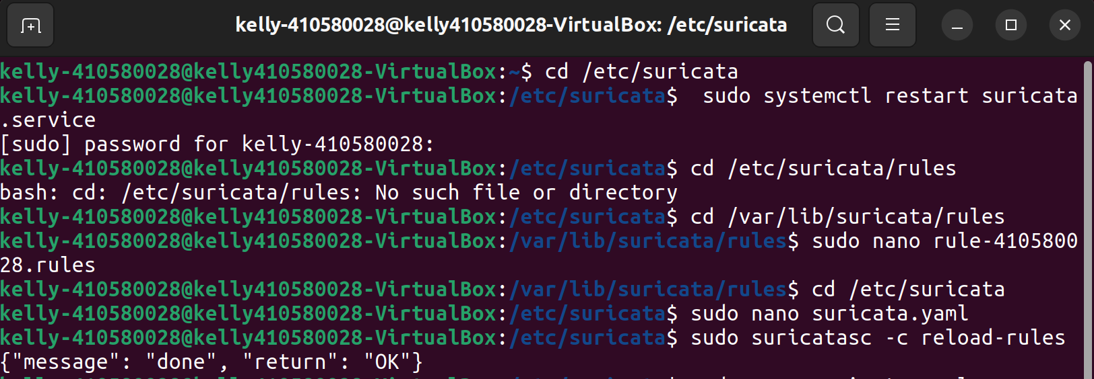
Suricata 新增規則
cd /etc/suricata/
sudo nano suricata.yaml

Slide 35
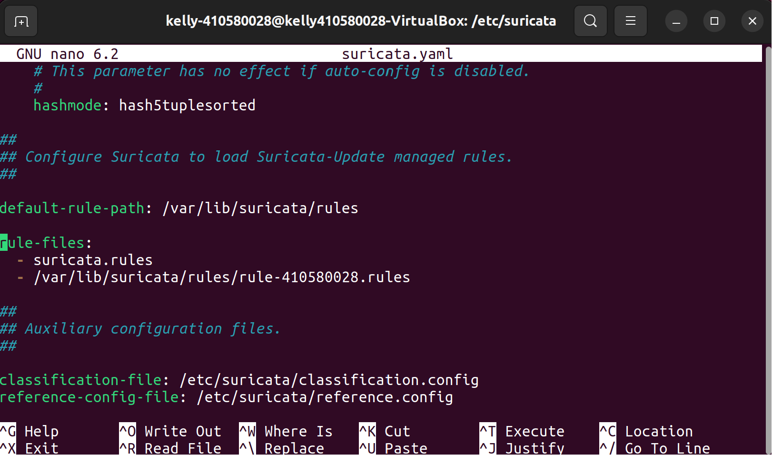
Suricata 規則更改路徑
/var/lib/Suricata/rules/rule/410580028.rules

Slide 36
Suricata 重新載入規則
sudo suricatasc -c reload-rules

Slide 37
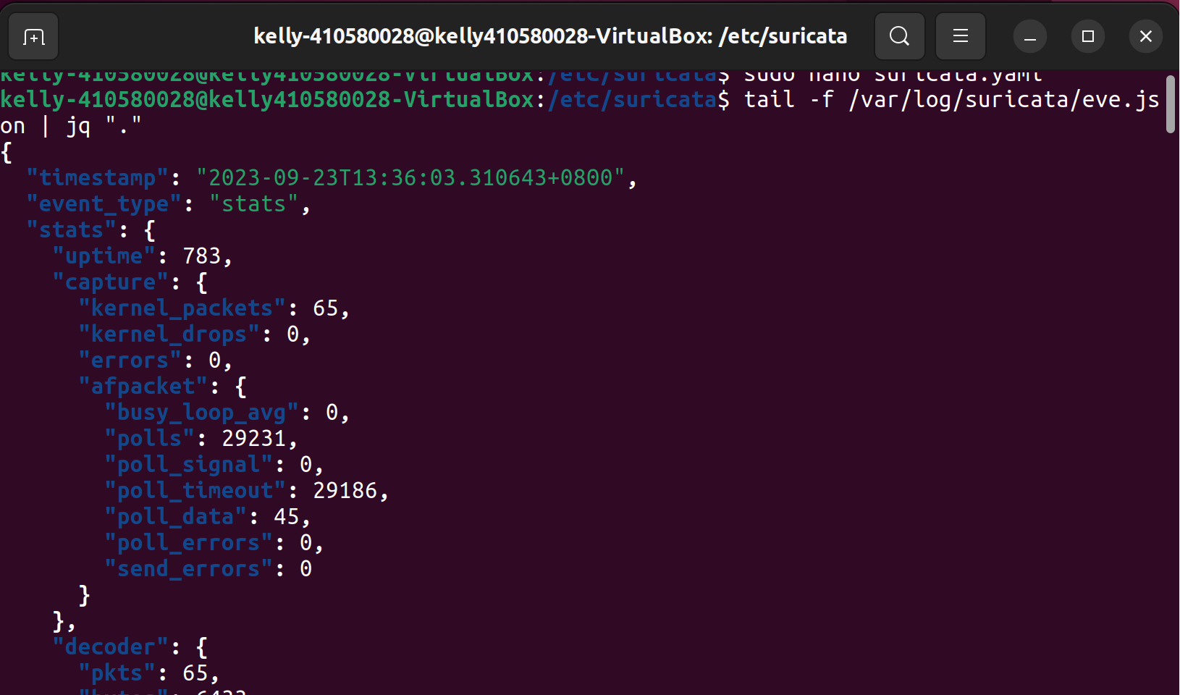
Suricata 測試規則
tail -f /var/log/suricata/eve.json | jq "."

Slide 38
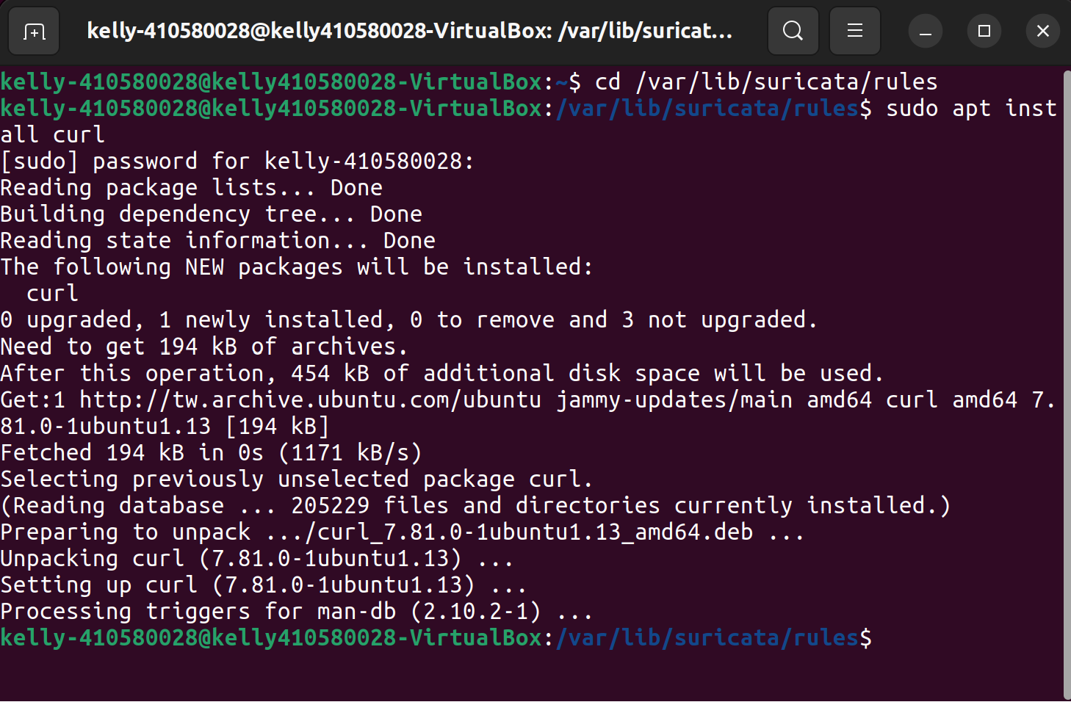
Suricata curl測試
sudo apt install curl

Slide 39
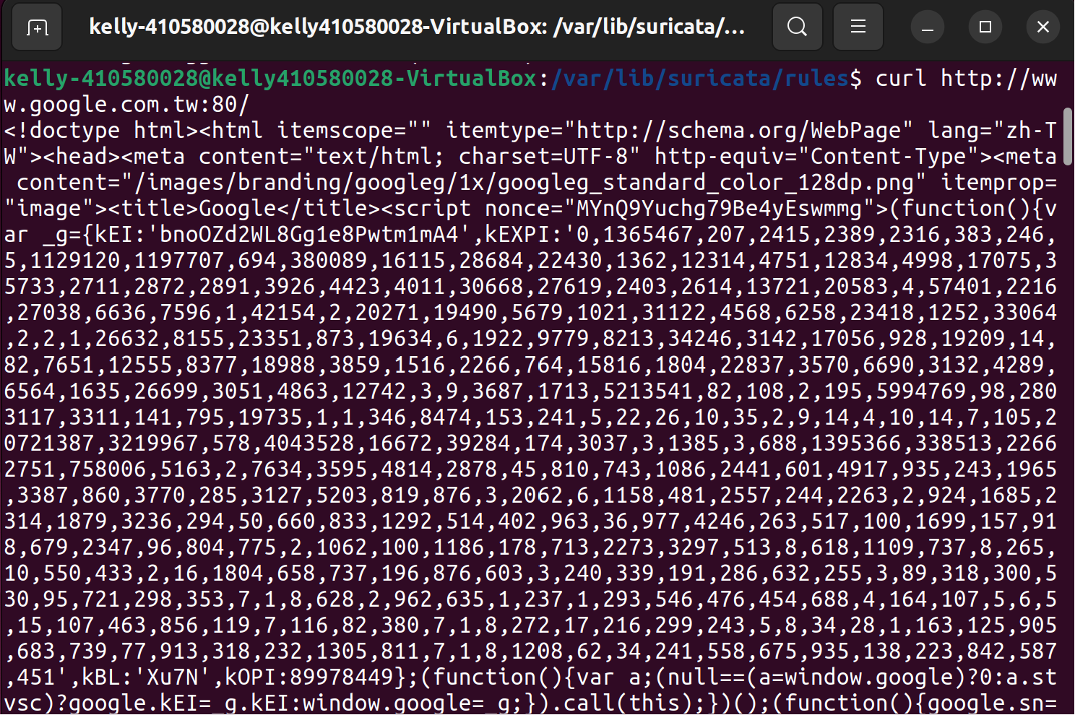
Suricata curl測試
curl http://www.google.com.tw:80/

Slide 40
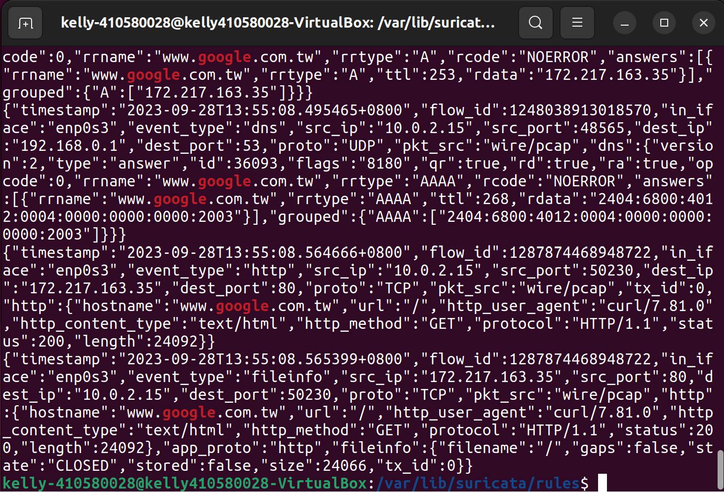
Suricata curl測試
sudo cat /var/log/suricata/eve.json | grep “google”

Slide 41
Thanks

